Slide 1

Multiple Regression Analysis
Chapter 14
McGraw-Hill/Irwin
Copyright © 2012 by The McGraw-Hill Companies, Inc. All rights reserved.

Slide 2
Learning Objectives
LO1 Describe the relationship between several independent variables
and a dependent variable using multiple regression analysis.
LO2 Set up, interpret, and apply an ANOVA table
LO3 Compute and interpret measures of association in multiple
regression.
LO4 Conduct a test of hypothesis to determine whether a set of
regression coefficients differ from zero.
LO5 Conduct a test of hypothesis on each of the regression coefficients.
LO6 Use residual analysis to evaluate the assumptions of multiple
regression analysis.
LO7 Evaluate the effects of correlated independent variables.
LO8 Evaluate and use qualitative independent variables.
LO9 Explain the possible interaction among independent variables
L10 Explain stepwise regression.
14-2

Slide 3
Multiple Regression Analysis
LO1 Describe the relationship between several independent variables and a dependent variable using multiple regression analysis.
The general multiple regression with k independent variables is given by:
X₁ … X_{k} are the independent variables.
a is the Y-intercept
b₁ is the net change in Y for each unit change in X₁ holding X₂ … X_{k} constant. It is called a partial regression coefficient or just a regression coefficient.
The least squares criterion is used to develop this equation.
Determining b₁, b₂, etc. is very tedious, a software package such as Excel or MINITAB is recommended.
14-3

Slide 4
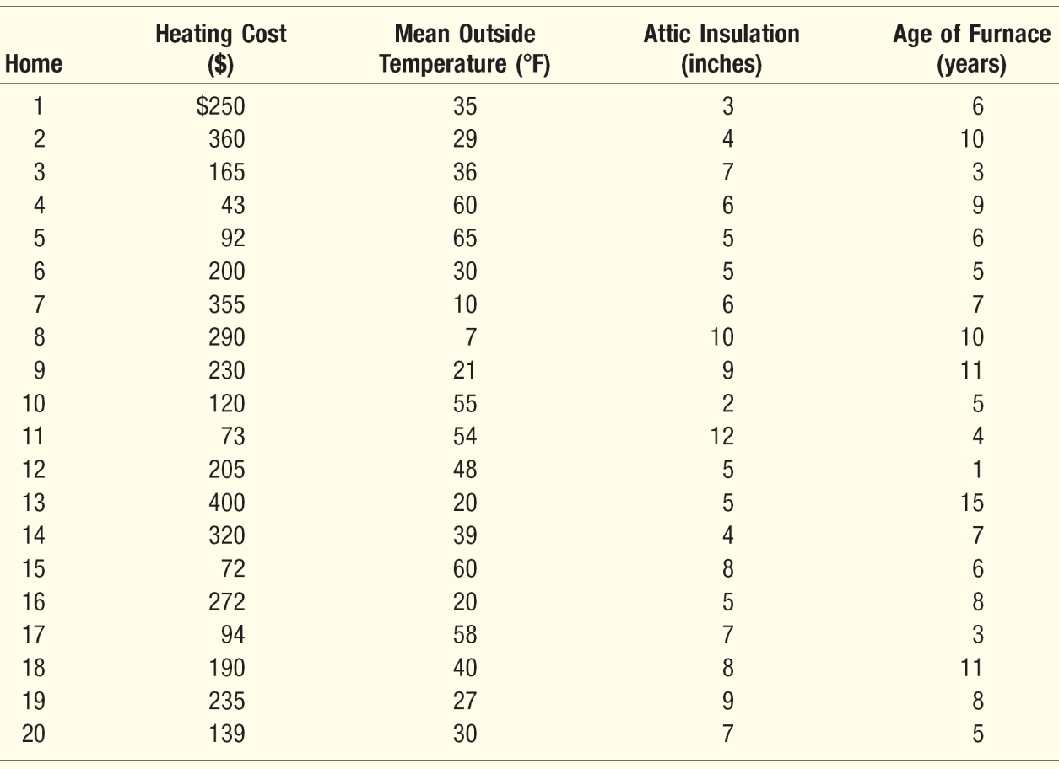
Multiple Linear Regression - Example
LO1
X₁
X₂
X₃
Salsberry Realty sells homes along the east coast of the United States. One of the questions most frequently asked by prospective buyers is: If we purchase this home, how much can we expect to pay to heat it during the winter? The research department at Salsberry has been asked to develop some guidelines regarding heating costs for single-family homes.
Three variables are thought to relate to the heating costs: (1) the mean daily outside temperature, (2) the number of inches of insulation in the attic, and (3) the age in years of the furnace.
To investigate, Salsberry’s research department selected a random sample of 20 recently sold homes. It determined the cost to heat each home last January, as well
14-4

Slide 5
The Multiple Regression Equation – Interpreting the Measures of Association and Applying the Model for Estimation
LO1
Interpreting the Regression Coefficients
The regression coefficient for mean outside temperature, X₁, is 4.583. The coefficient is negative – as the outside temperature increases, the cost to heat the home decreases. For every unit increase in temperature, holding the other two independent variables constant, monthly heating cost is expected to decrease by $4.583 .
The attic insulation variable, X₂, also shows an inverse relationship (negative coefficient). The more insulation in the attic, the less the cost to heat the home. For each additional inch of insulation, the cost to heat the home is expected to decline by $14.83 per month.
The age of the furnace variable shows a direct relationship. With an older furnace, the cost to heat the home increases. For each additional year older the furnace is, the cost is expected to increase by $6.10 per month.
Applying the Model for Estimation
What is the estimated heating cost for a home if the mean outside temperature is 30 degrees, there are 5 inches of insulation in the attic, and the furnace is 10 years old?
14-5

Slide 6
Multiple Linear Regression – ANOVA Table
LO2 Set up, interpret, and apply an ANOVA table
Regression outputs produced by
Minitab and Excel
a
b₁
b₂
b₃
14-6

Slide 7
Multiple Standard Error of Estimate
LO3
The multiple standard error of estimate is a measure of the effectiveness of the regression equation.
It is measured in the same units as the dependent variable.
It is difficult to determine what is a large value and what is a small value of the standard error.
14-7

Slide 8
Multiple Regression and Correlation Assumptions
LO3
The independent variables and the dependent variable have a linear relationship. The dependent variable must be continuous and at least interval-scale.
The residual must be the same for all values of Y. When this is the case, we say the difference exhibits homoscedasticity.
The residuals should follow the normal distributed with mean 0.
Successive values of the dependent variable must be uncorrelated.
14-8

Slide 9
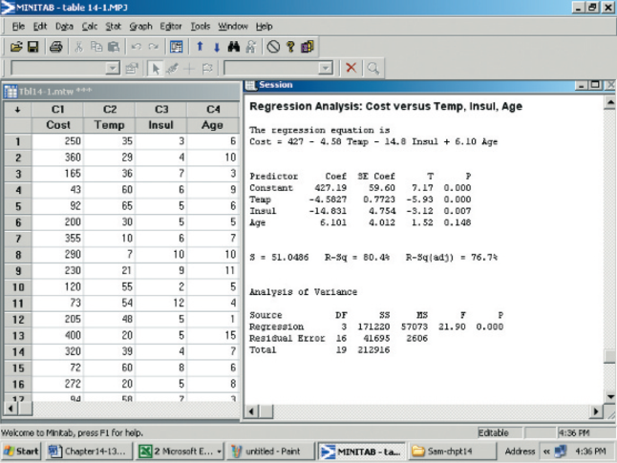
Coefficient of Multiple Determination (r²)
LO3 Compute and interpret measures of association in multiple regression.
Coefficient of Multiple Determination:
Symbolized by R².
Ranges from 0 to 1.
Cannot assume negative values.
Easy to interpret.
The Adjusted R²
The number of independent variables in a multiple regression equation makes the coefficient of determination larger.
If the number of variables, k, and the sample size, n, are equal, the coefficient of determination is 1.0.
To balance the effect that the number of independent variables has on the coefficient of multiple determination, adjusted R² is used instead.
14-9
Notes:
.

Slide 10
Global Test: Testing the Multiple Regression Model
LO4 Conduct a hypothesis test to determine whether a set of regression coefficients differ from zero.
The global test is used to investigate whether any of the independent variables have significant coefficients.
The hypotheses are:
Decision Rule:
Reject H₀ if F > F_{α,k,n-k-1}
14-10

Slide 11
Finding the Computed and Critical F
LO4
F_{α,k,n-k-1}
F_{.05,3,16}
14-11

Slide 12
Interpretation
LO4
The computed value of F is 21.90, which is in the rejection region.
The null hypothesis that all the multiple regression coefficients are zero is therefore rejected.
Interpretation: some of the independent variables (amount of insulation, etc.) do have the ability to explain the variation in the dependent variable (heating cost).
Logical question – which ones?
21.9
14-12

Slide 13
Evaluating Individual Regression Coefficients (β_{i} = 0)
LO5 Conduct a hypothesis test of each regression coefficient.
This test is used to determine which independent variables have nonzero regression coefficients.
The variables that have zero regression coefficients are usually dropped from the analysis.
The test statistic is the t distribution with n-(k+1) degrees of freedom.
The hypothesis test is as follows:
H₀: β_{i} = 0
H₁: β_{i} ≠ 0
Reject H₀ if t > t_{α/2,n-k-1} or t < -t_{α/2,n-k-1}
14-13

Slide 14
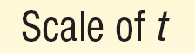
Critical t for the Slopes
LO5
-2.120
2.120
14-14

Slide 15
Computed t for the Slopes
LO5
14-15

Slide 16
Conclusion on Significance of Slopes
LO5
-2.120
2.120
-5.93
(Temp)
-3.119
(Insulation)
1.521
(Age)
14-16

Slide 17
New Regression Model without Variable “Age” – Minitab
LO5
14-17

Slide 18
New Regression Model without Variable “Age” – Minitab
LO5
14-18

Slide 19

Testing the New Model for Significance
LO5
d.f. (2,17)
3.59
Computed F = 29.42
14-19

Slide 20
Critical t-stat for the New Slopes
LO5
-2.110
2.110
14-20

Slide 21
Conclusion on Significance of New Slopes
LO5
-2.110
2.110
-7.34
(Temp)
-2.98
Insulation
14-21
Notes:
.

Slide 22
Evaluating the Assumptions of Multiple Regression
LO6 Use residual analysis to evaluate the assumptions of multiple regression analysis.
1. There is a linear relationship. That is, there is a straight-line relationship between the dependent variable and the set of independent variables.
2. The variation in the residuals is the same for both large and small values of the estimated Y To put it another way, the residual is unrelated whether the estimated Y is large or small.
3. The residuals follow the normal probability distribution.
4. The independent variables should not be correlated. That is, we would like to select a set of independent variables that are not themselves correlated.
5. The residuals are independent. This means that successive observations of the dependent variable are not correlated. This assumption is often violated when time is involved with the sampled observations.
A residual is the difference between the actual value of Y and the predicted value of Y.
14-22

Slide 23
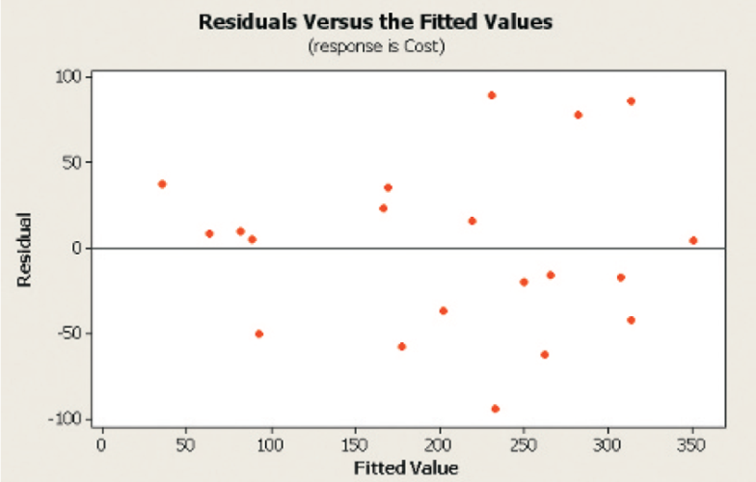
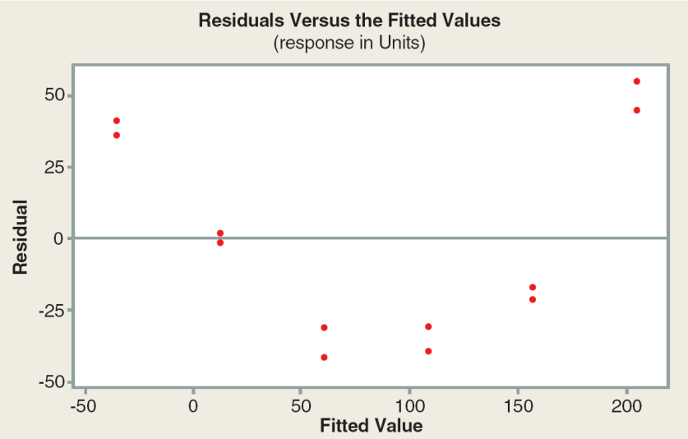
Scatter and Residual Plots
LO6
A plot of the residuals and their corresponding Y’ values is used for showing that there are no trends or patterns in the residuals.
14-23

Slide 24
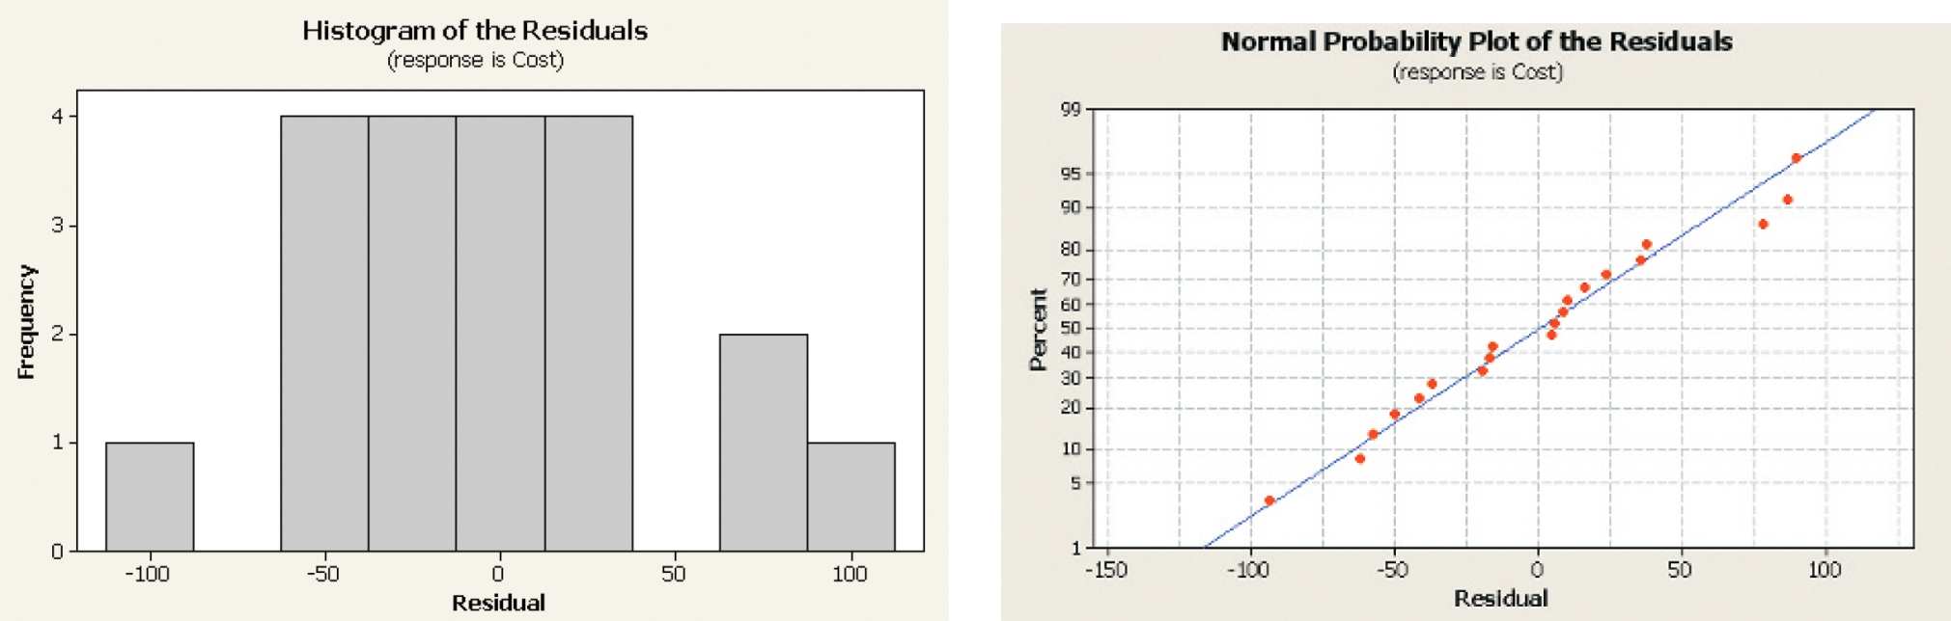
Distribution of Residuals
LO6
Both MINITAB and Excel offer another graph that helps to evaluate the assumption of normally distributed residuals. It is a called a normal probability plot and is shown to the right of the histogram.
14-24
Notes:
.

Slide 25
Multicollinearity
LO7 Evaluate the effects of correlated independent variables.
Multicollinearity exists when independent variables (X’s) are correlated.
Effects of Multicollinearity on the Model:
1. An independent variable known to be an important predictor ends up having a regression coefficient that is not significant.
2. A regression coefficient that should have a positive sign turns out to be negative, or vice versa.
3. When an independent variable is added or removed, there is a drastic change in the values of the remaining regression coefficients.
However, correlated independent variables do not affect a multiple regression equation’s ability to predict the dependent variable (Y).
14-25

Slide 26
Variance Inflation Factor
LO7
A general rule is if the correlation between two independent variables is between -0.70 and 0.70 there likely is not a problem using both of the independent variables.
A more precise test is to use the variance inflation factor (VIF).
A VIF > 10 is unsatisfactory. Remove that independent variable from the analysis.
The value of VIF is found as follows:
The term R²_{j} refers to the coefficient of determination, where the selected independent variable is used as a dependent variable and the remaining independent variables are used as independent variables.
14-26

Slide 27
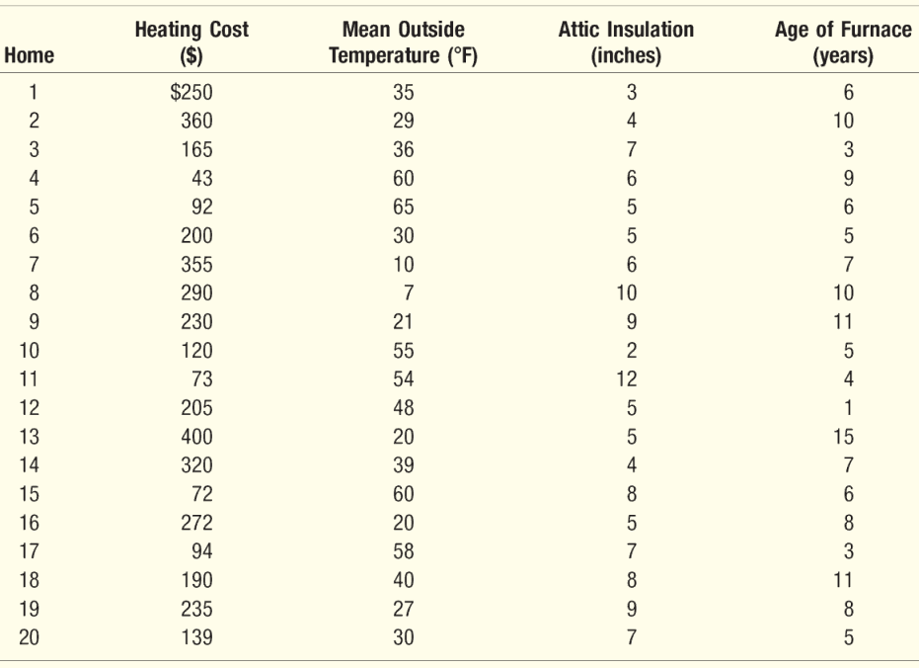
Multicollinearity – Example
LO7
Refer to the data in the table, which relates the heating cost to the independent variables outside temperature, amount of insulation, and age of furnace.
Develop a correlation matrix for all the independent variables.
Does it appear there is a problem with multicollinearity?
Find and interpret the variance inflation factor for each of the independent variables.
Correlation Matrix of the Variables
14-27

Slide 28
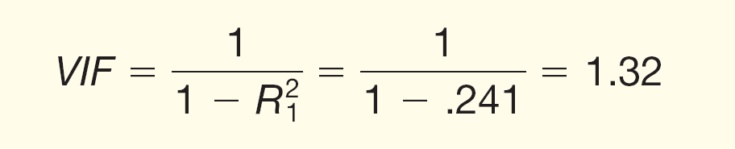
VIF – Minitab Example
LO7
Coefficient of
Determination
The VIF value of 1.32 is less than the upper limit of 10. This indicates that the independent variable temperature is not strongly correlated with the other independent variables.
14-28
Notes:
.

Slide 29
Independence Assumption
LO7
The fifth assumption about regression and correlation analysis is that successive residuals should be independent.
When successive residuals are correlated we refer to this condition as autocorrelation. Autocorrelation frequently occurs when the data are collected over a period of time.
14-29

Slide 30
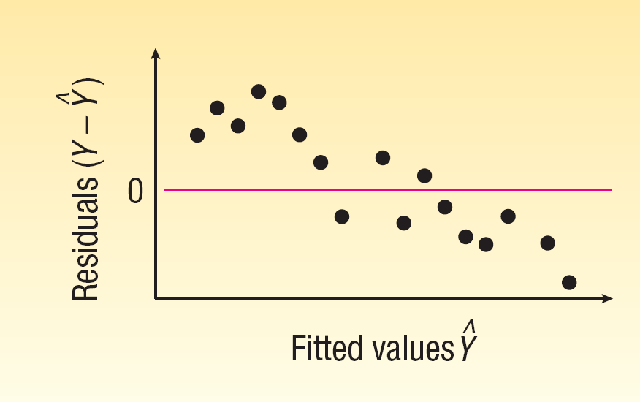
Residual Plot versus Fitted Values: Testing the Independence Assumption
LO7
When successive residuals are correlated we refer to this condition as autocorrelation, which frequently occurs when the data are collected over a period of time.
Note the run of residuals above the mean of the residuals, followed by a run below the mean. A scatter plot such as this would indicate possible autocorrelation.
14-30

Slide 31
Qualitative Variable - Example
LO8 Evaluate and use qualitative independent variables.
Frequently we wish to use nominal-scale variables—such as gender, whether the home has a swimming pool, or whether the sports team was the home or the visiting team—in our analysis. These are called qualitative variables.
To use a qualitative variable in regression analysis, we use a scheme of dummy variables in which one of the two possible conditions is coded 0 and the other 1.
EXAMPLE
Suppose in the Salsberry Realty example that the independent variable “garage” is added. For those homes without an attached garage, 0 is used; for homes with an attached garage, a 1 is used. We will refer to the “garage” variable as The data from Table 14–2 are entered into the MINITAB system.
14-31

Slide 32
Qualitative Variable - Minitab
LO8
Garage as ‘dummy’
variable
14-32

Slide 33
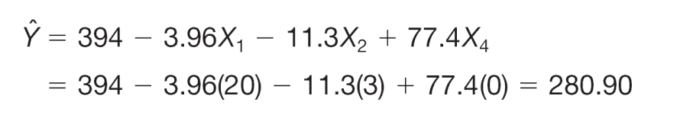
Using the Model for Estimation
LO8
What is the effect of the garage variable? Suppose we have two houses exactly alike next to each other in Buffalo, New York; one has an attached garage, and the other does not. Both homes have 3 inches of insulation, and the mean January temperature in Buffalo is 20 degrees.
For the house without an attached garage, a 0 is substituted for in the regression equation. The estimated heating cost is $280.90, found by:
For the house with an attached garage, a 1 is substituted for in the regression equation. The estimated heating cost is $358.30, found by:
Without garage
With garage
14-33

Slide 34
Evaluating Individual Regression Coefficients (β_{i} = 0)
LO8
This test is used to determine which independent variables have nonzero regression coefficients.
The variables that have zero regression coefficients are usually dropped from the analysis.
The test statistic is the t distribution with n-(k+1) or n-k-1degrees of freedom.
The hypothesis test is as follows:
H₀: β_{i} = 0
H₁: β_{i} ≠ 0
Reject H₀ if t > t_{α/2,n-k-1} or t < -t_{α/2,n-k-1}
14-34

Slide 35
Testing Variable “Garage” for Significance
LO8
-2.120
2.120
Conclusion: The regression coefficient is not zero. The independent variable garage should be included in the analysis.
14-35

Slide 36
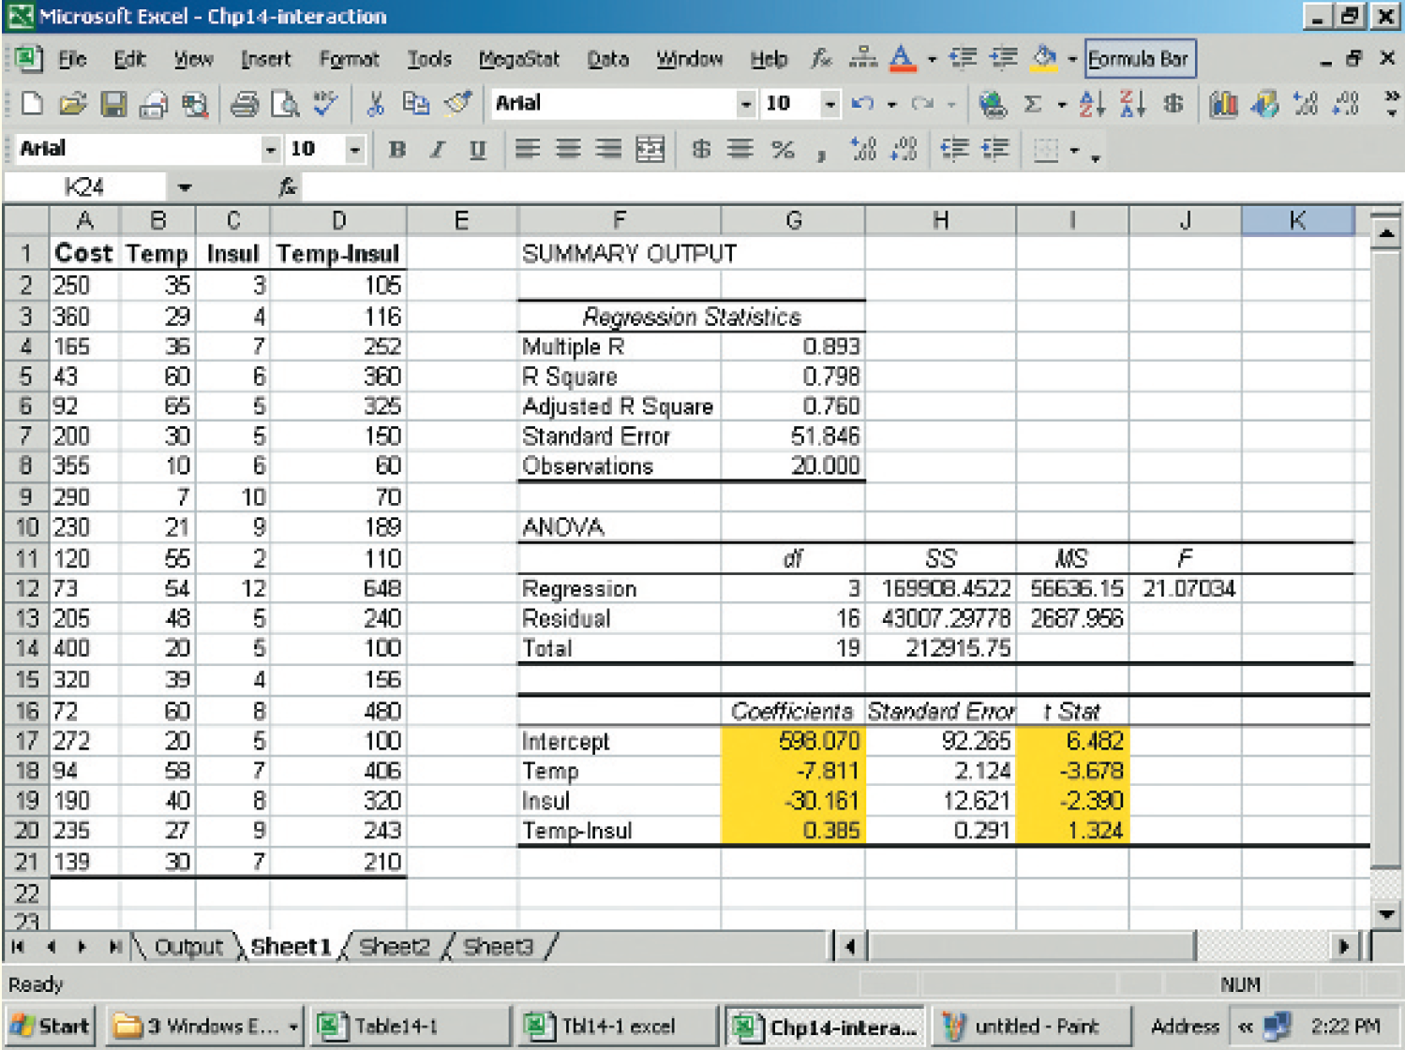
Regression Models with Interaction - Example
LO9 Explain the possible interaction among independent variables.
Creating the Interaction Variable – Using the information from the table in the previous slide, an interaction variable is created by multiplying the temperature variable by the insulation.
For the first sampled home the value temperature is 35 degrees and insulation is 3 inches so the value of the interaction variable is 35 X 3 = 105. The values of the other interaction products are found in a similar fashion.
14-36

Slide 37
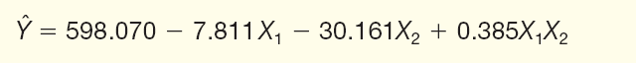
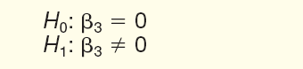
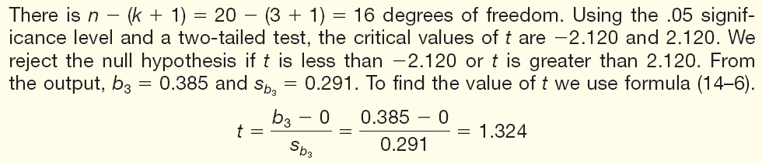
Regression Models with Interaction - Example
LO9
The regression equation is:
Is the interaction variable significant at 0.05 significance level?
14-37

Slide 38
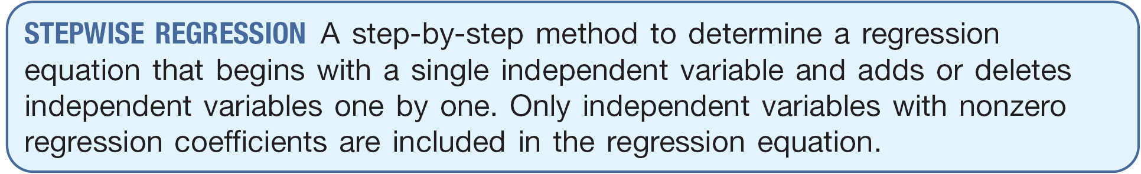
Stepwise Regression
LO10 Explain stepwise regression
The advantages to the stepwise method are:
1. Only independent variables with significant regression coefficients are entered into the equation.
2. The steps involved in building the regression equation are clear.
3. It is efficient in finding the regression equation with only significant regression coefficients.
4. The changes in the multiple standard error of estimate and the coefficient of determination are shown.
14-38

Slide 39
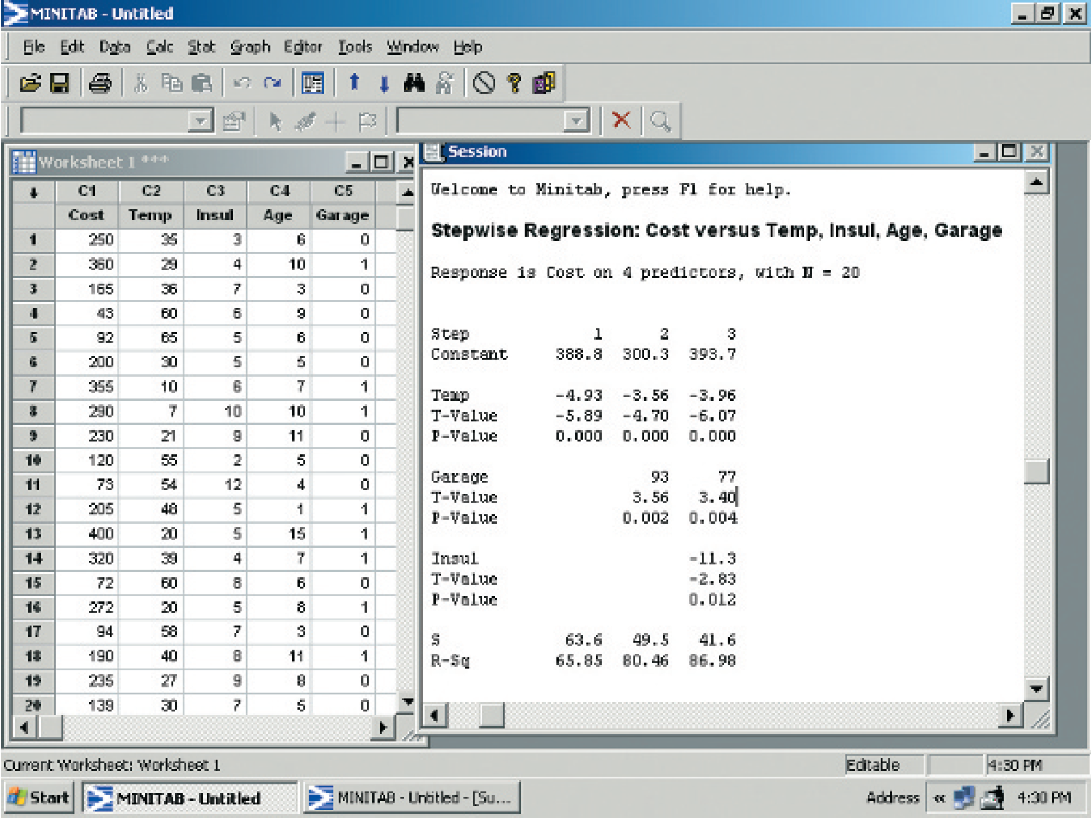
Stepwise Regression – Minitab Example
LO10
The stepwise MINITAB output for the heating cost problem follows.
Temperature is selected first. This variable explains more of the variation in heating cost than any of the other three
proposed independent variables.
Garage is selected next, followed by Insulation.
14-39

